Slide 1
Computer Organization and Software Systems Webinar 3 – CPU scheduling algorithms
Vivekananda M R

Slide 2

CPU Scheduling Algorithms
FCFS (First Come First Serve)
SJF (Shortest Job First)
Preemptive / SRTF (Shortest Remaining Time First)
Non-Preemptive
Priority scheduling
Preemptive
Non-Preemptive
Round Robin (RR)

Slide 3
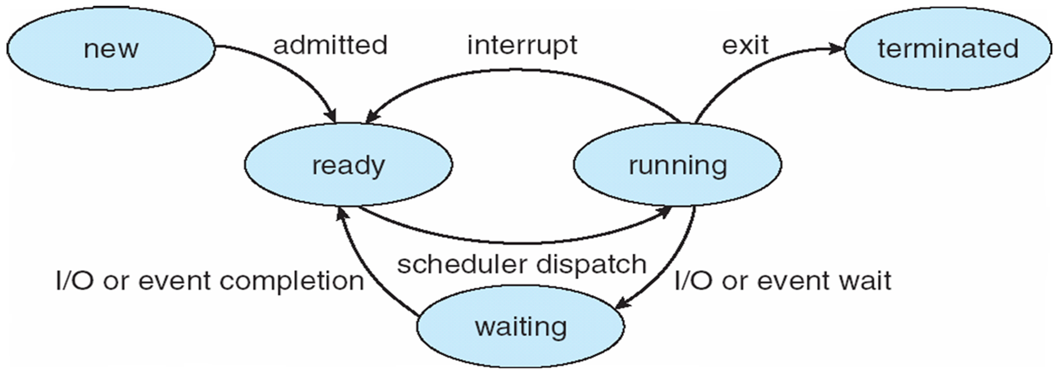


Key terminologies
Process States
The state of a process is defined in part by the current activity of that process.
New: The process is being created.
Running: Instructions are being executed.
Waiting: The process is waiting for some event to occur (such as an I/O completion or reception of a signal).
Ready: The process is waiting to be assigned to a processor.
Terminated: The process has finished execution.

Slide 4
Key terminologies
Non-Preemptive Scheduling:
Once the resources (CPU cycles) is allocated to a process, the process holds the CPU till it gets terminated.
Preemptive Scheduling:
The resources (mainly CPU cycles) are allocated to the process for the limited amount of time and then is taken away, and the process is again placed back in the ready queue if that process still has CPU burst time remaining.

Slide 5
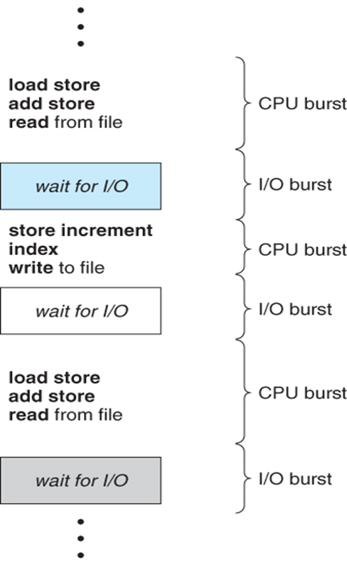

Key terminologies
CPU burst is length of time process needs to use CPU before it next makes a system call (normally request for I/O).
I/O burst is the length of time process spends waiting for I/O to complete.

Slide 6
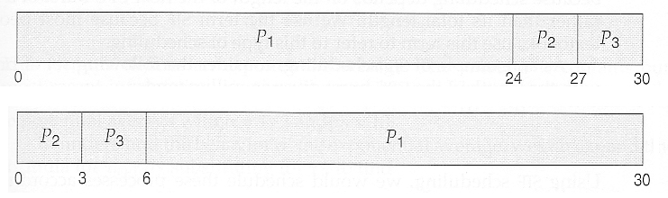
Key terminologies
GANTT chart:
Generalized Activity Normalization Timetable (GANTT).
Type of chart that show the amount of work done or production completed in given period of time.

Slide 7
Key terminologies
Different time with respect to a process.
Arrival Time (AT):
Time at which the process arrives in the ready queue.
Completion Time (CT):
Time at which process completes its execution.
Burst Time (BT):
Time required by a process for CPU execution.
Turn Around Time (TAT):
Time Difference between completion time and arrival time.
Turn Around Time = Completion Time – Arrival Time
Waiting Time(WT):
Time Difference between turn around time and burst time.
Waiting Time = Turn Around Time – Burst Time
Response Time(WT):
RT = Start Time – Arrival Time

Slide 8
Problem1 : FCFS
Consider a System with four processes P1,P2,P3 and P4 whose arrival time and CPU-I/O bursts are as given in the table. Find average Turn Around Time, Waiting Time and Response Time.
Process | AT | BT |  |  | FT | TAT | WT | RT
 |  | CPU | I/O | CPU
P1 | 0 | 6 | 3 | 2
P2 | 2 | 5 | 1 | 1
P3 | 3 | 2 | 1 | 3
P4 | 5 | 1 | 1 | 1
AT – Arrival Time BT – Bust Time FT – Finish Time
TAT – Turn Around Time WT – Wait Time RT – Response Time

Slide 9
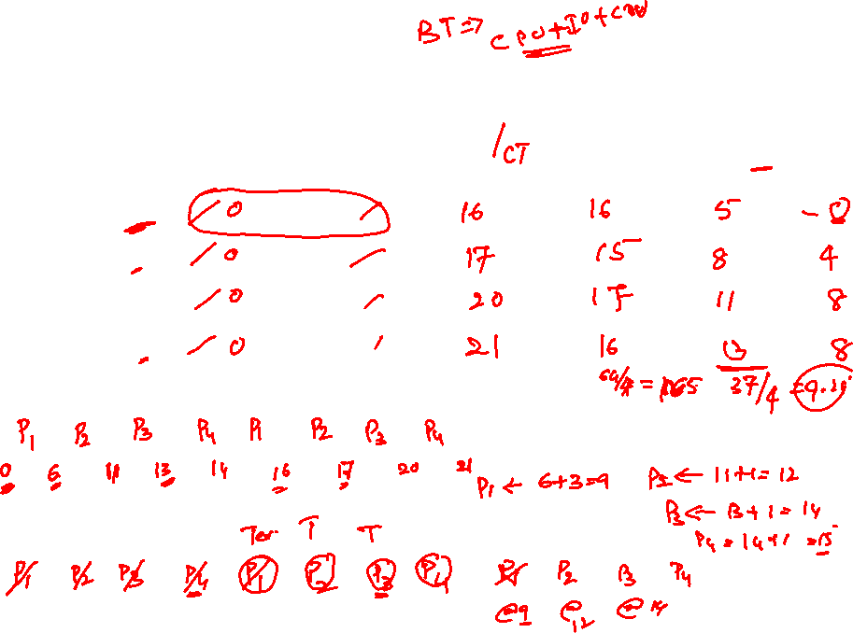
Problem-1 : FCFS
Process | AT | BT |  |  | FT | TAT (FT-AT) | WT (TAT-BT) | RT
 |  | CPU | I/O | CPU
P1 | 0 | 6 | 3 | 2
P2 | 2 | 5 | 1 | 1
P3 | 3 | 2 | 1 | 3
P4 | 5 | 1 | 1 | 1
Gantt Chart
Ready Queue
I/O (Wait Queue)

Slide 10
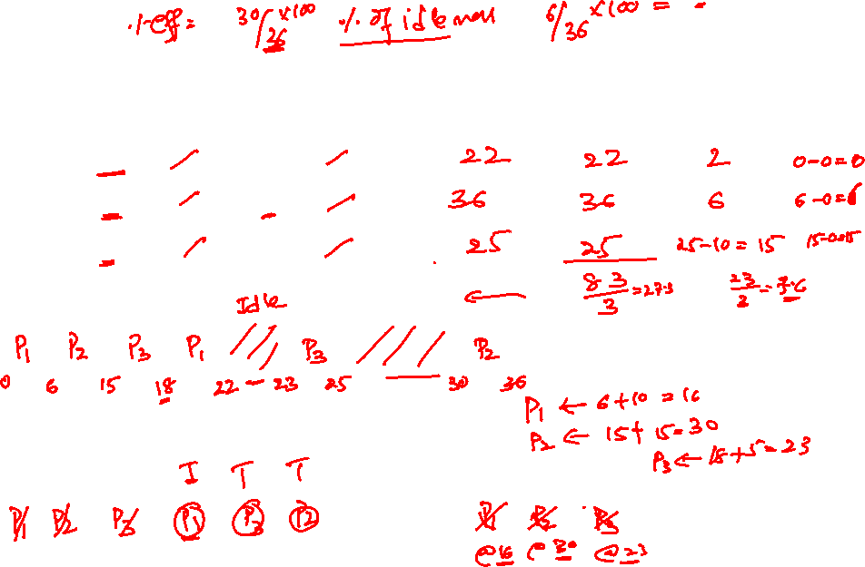
Problem-2 : FCFS
Process | AT | BT |  |  | FT | TAT (FT-AT) | WT (TAT-BT) | RT
 |  | CPU | I/O | CPU
P1 | 0 | 6 | 10 | 4
P2 | 0 | 9 | 15 | 6
P3 | 0 | 3 | 5 | 2
Gantt Chart
Ready Queue
I/O (Wait Queue)

Slide 11
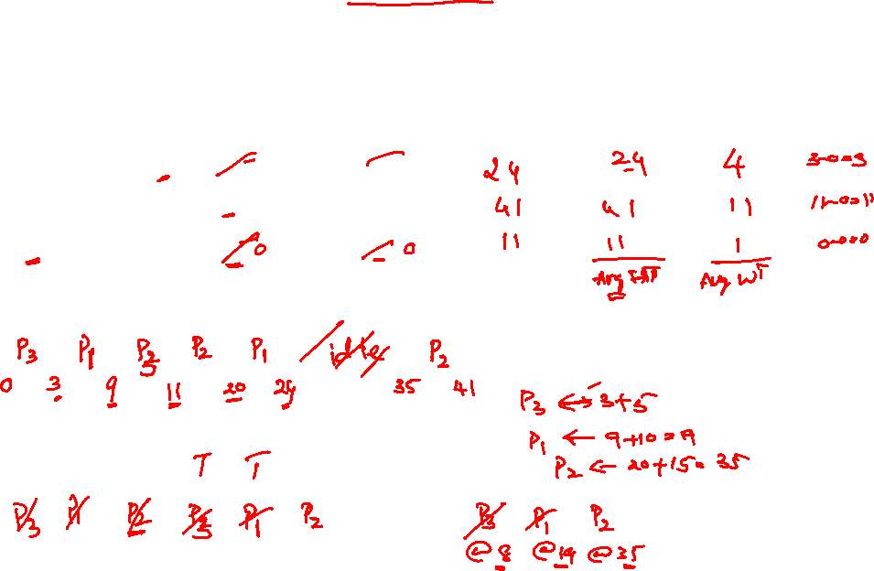
Problem-3 : SJF (Non-Preemptive)
Process | AT | BT |  |  | FT | TAT (FT-AT) | WT (TAT-BT) | RT
 |  | CPU | I/O | CPU
P1 | 0 | 6 | 10 | 4
P2 | 0 | 9 | 15 | 6
P3 | 0 | 3 | 5 | 2
Gantt Chart
Ready Queue
I/O

Slide 12
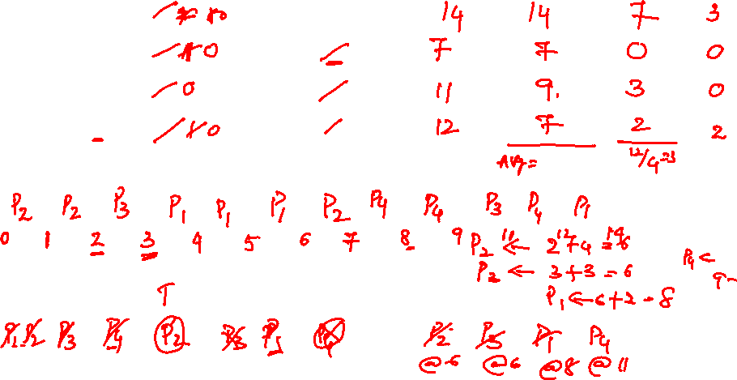
Problem-4 : SJF (Preemptive) /SRTF
Process | AT | BT |  |  | FT | TAT (FT-AT) | WT (TAT-BT) | RT
 |  | CPU | I/O | CPU
P1 | 0 | 3 | 2 | 2
P2 | 0 | 2 | 4 | 1
P3 | 2 | 1 | 3 | 2
P4 | 5 | 2 | 2 | 1
Gantt Chart
Ready Queue
I/O (Wait Queue)

Slide 13
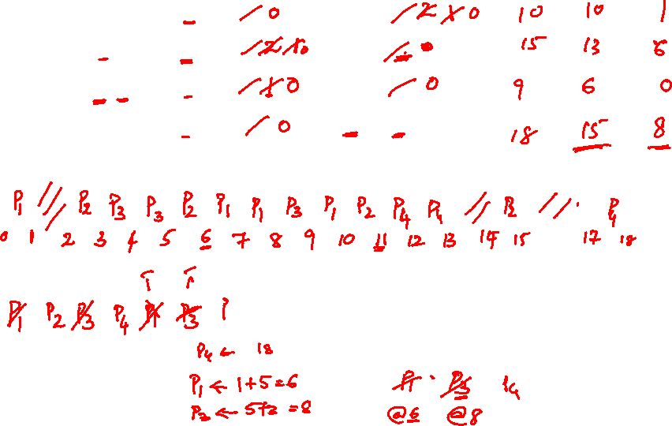
Problem-5 : Priority Scheduling(Preemptive)
Process | Priority | AT | BT |  |  | FT | TAT | WT | RT
 |  |  | CPU | I/O | CPU
P1 | 2 | 0 | 1 | 5 | 3
P2 | 3 | 2 | 3 | 3 | 1
P3 | 1[H] | 3 | 2 | 3 | 1
P4 | 4[L] | 3 | 2 | 4 | 1
Gantt Chart
Ready Queue
I/O (Wait Queue)

Slide 14
Problem-6 : Priority Scheduling (Preemptive)
Process | Priority | AT | BT |  |  | FT | TAT (FT-AT) | WT (TAT-BT) | RT
 |  |  | CPU | I/O | CPU
P1 | 2 | 0 | 1 | 5 | 3
P2 | 3 [L] | 2 | 3 | 3 | 1
P3 | 1 [H] | 3 | 2 | 3 | 1
Gantt Chart
Ready Queue
I/O

Slide 15
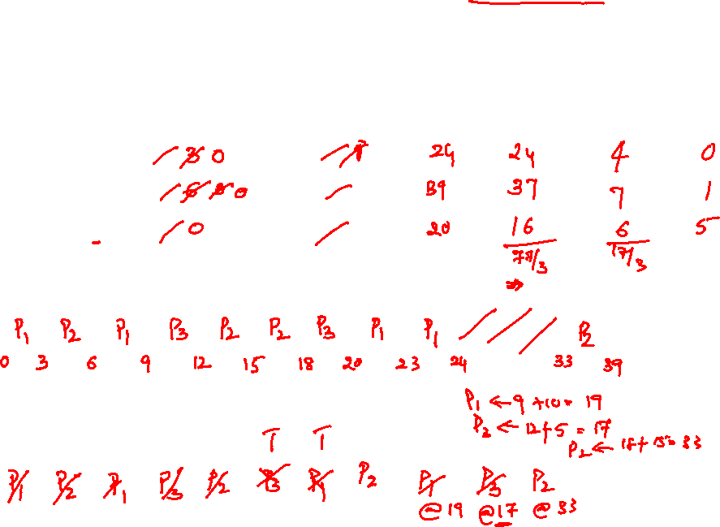
Problem-7 : Round Robin Quantum=3
Process | AT | BT |  |  | FT | TAT (FT-AT) | WT (TAT-BT) | RT
 |  | CPU | I/O | CPU
P1 | 0 | 6 | 10 | 4
P2 | 2 | 9 | 15 | 6
P3 | 4 | 3 | 5 | 2
Gantt Chart
Ready Queue
I/O(Wait Queue)

Slide 16
Problem-8 : Round Robin Quantum=3
Process | AT | BT |  |  | FT | TAT (FT-AT) | WT (TAT-BT) | RT
 |  | CPU | I/O | CPU
P1 | 0 | 4 | 2 | 6
P2 | 2 | 6 | 2 | 6
P3 | 4 | 8 | 3 | 5
P4 | 8 | 7 | 2 | 4
Gantt Chart
I/O(Wait Queue)
Ready Queue

Slide 17
Problem-9 : SJF (Non-Preemptive) - HW
Process | AT | BT |  |  | FT | TAT (FT-AT) | WT (TAT-BT) | RT
 |  | CPU | I/O | CPU
P1 | 0 |  | 4
P2 | 2 |  | 2
P3 | 4 |  | 1
P4 | 6 |  | 2
3
3
4
4
5
4
2
4
Gantt Chart
Ready Queue
I/O

Slide 18
Problem-10 : FCFS (HW)
Process | AT | BT |  |  | FT | TAT (FT-AT) | WT (TAT-BT) | RT
 |  | CPU | I/O | CPU
P1 | 0 |  | 2
P2 | 2 |  | 2
P3 | 4 |  | 3
P4 | 8 |  | 2
3
4
5
3
3
1
4
2
Gantt Chart
Ready Queue
I/O

Slide 19
Questions ?

Slide 20
Thank you.

